Slide 1
Evaluative Thesis Statements
Examples and Explanations

Slide 2
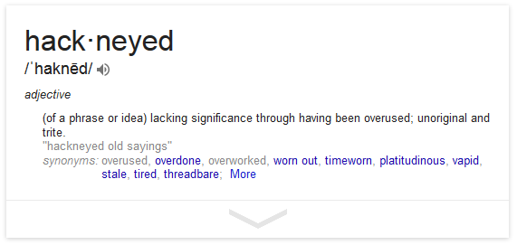
General Rule for Life: Don’t write a Paper to Confirm What people already Know
“This TV show that tries to show black women in positions of power definitely shows black women in positions of power!”
“This movie that shows how powerful women were involved in history definitely shows women being powerful and involved!”
“This documentary about little people taking on a big corporation definitely sends the message that little people can successfully take on powerful people!”
“This show that everyone agrees promotes terrible racial stereotypes definitely promotes racial stereotypes!”

Slide 3
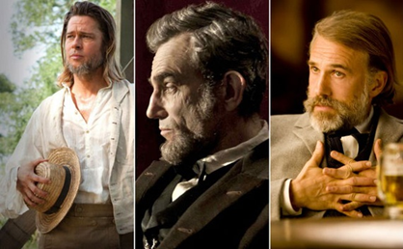
Saying something Original: A movie that Wants to be racially progressive
“As it is, in the context of Hollywood, Northup's stunned/numb gratitude at the end of the film tends to blur into a montage of other teary-eyed black actors gazing with awe and wonder at the surprising, over-determined nobility of some white actor or other”
–Berlatsky, “12 Years A Slave: Yet Another Oscar-Nominated White Savior Story”

Slide 4

Saying Something Original: A show with a “strong female lead”
“But Carrie is an unprofessional lunatic (not, by the way, due to her bipolarity) that puts peoples' lives in danger. If that's the bar for being a strong female character, it's set pretty low.”
—McInnis, “How 'Homeland' Undercuts Real Women in Government”

Slide 5
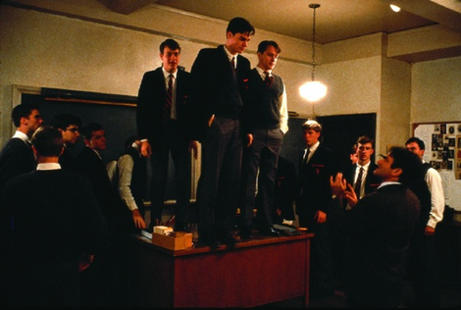
Say Something Original: A movie that uses the “inspirational teacher” trope
“The film’s anti-intellectualism is both quite visceral and quite violent,” and “while avoiding the pitfalls of dull pedagogy, Keating doesn’t finally give his students anything in its place besides a kind of vague enthusiasm”
—Dettmar, “Dead Poet’s Society Is a Terrible Defense of the Humanities”

Slide 6
Thesis Statements to Avoid
The show is fun to watch. [Irrelevant, unhelpful, boring…no one cares about fun.]
The show will surely inspire its audience to make a change in their own lives. [Illogical (you have no clue what the audience will do), irrelevant, saccharine, unintellectual.]
My claim about this movie is the same as everyone else’s claim about this movie. OR, I am making a claim about something around which there is no debate. [Then why on Earth are you writing this?]
This album is bad because it promotes stereotypes. [You need to be so much more specific, in every way.]
This video game promotes patriarchal norms through X, Y, and Z. [Are we in 9th grade?]

Slide 7
Anatomy of a Successful Thesis
Far from being a neutral piece of mindless entertainment, NCIS aggressively encourages citizens to hand over their Constitutional rights for the good of an imaginary society living with the constant threat of immediate peril.
Right away, the author shows how his view is different from other perspectives on the show. He defines the debate he is entering into. This makes his claim stand out as unique and important.
If your thesis doesn’t mention the primary source, you have a problem!
Highly specific claim about exactly what the show promotes.
One word can say a lot! This word tells the audience that the author does NOT like the message of the show. He thinks it is BAD for culture.
Note how the author has a claim about A) the message NCIS sends, and B) the kind of society it presents, along with his view that this is a problematic and unrealistic message. There is a lot packed into this thesis, and a lot to do in the body. Note also: there IS NO LIST OF POINTS!

